Slide 1

TA Timetabler
Supporting School SEND Departments
www.tatimetabler.co.uk
www.abacusedutech.co.uk

Slide 2
TA Timetabler
The company behind it: Abacus Edutech
The information it uses
The problem it solves
How it works
How it benefits schools
Testimonials
Pricing
Next steps

Slide 3
Abacus Edutech
The company behind TA Timetabler
Formed in January 2022
Its two founders have a combined experience of over 40 years in education, software development and technical architecture
A small and growing company that is responsive to its clients’ needs
Around 400 secondary schools have adopted TA Timetabler in total from June 2023 to January 2026)
Over two-thirds of schools that have had a free trial have purchased an annual subscription

Slide 4
TA Timetabler
The information it uses
Web application –connects to your school’s MIS (e.g. SIMS, Arbor, Bromcom) using Wonde
Staff, pupil and timetable data are copied into TA Timetabler and synchronised daily (no data is written back to the MIS)
The application is hosted on Microsoft Azure servers in the UK and all data is encrypted in transit and at rest
The setup is ‘self-service’. Once the Wonde connection has been approved, it usually takes just a few working hours for manual checks to be completed and your connection to become active
Main users are SENCOs and SEN administrators

Slide 5
TA Timetabler
The problem it solves
SEND needs are spread throughout many classes and year groups each day. Prioritising those needs and assigning all the TAs across every period of the timetable is a painstaking task.
Once complete, a TA Timetable is easily disrupted by student or staff illness, or timetable changes. Making corrections due to these factors is also a lengthy process that can happen on a daily basis.
Teaching staff are often unaware of what support they will be getting in each of their lessons, especially when changes are made

Slide 6
TA Timetabler
How it works
You identify the in-lesson support requirements of your EHCP/other SEND students
Using these requirements as a guide, TA timetables can be quickly created and customised
TAs can be quickly redeployed to cover absences
Custom lessons can be created for clubs, interventions and exam access arrangements
Created timetables can be easily exported, printed and emailed
TAs (and any other school staff) can be given view-only access to the system
A dashboard alerts users to changes in TA cover that need attention, including under and over covered lessons or TAs that are under-utilised

Slide 7
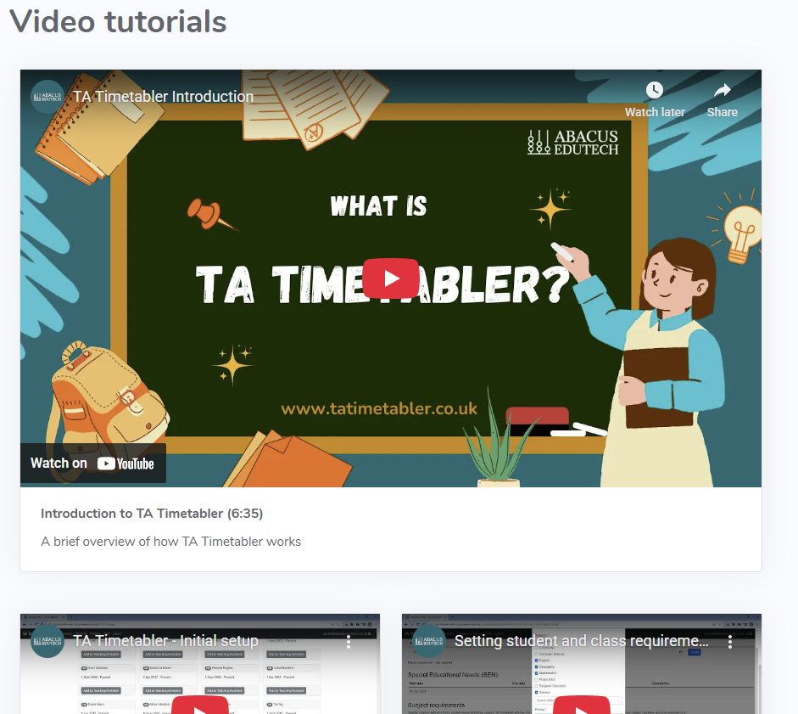
TA Timetabler
How it works
For demonstrations of how the key parts of the system work, see our video tutorials: www.tatimetabler.co.uk/help/videos

Slide 8
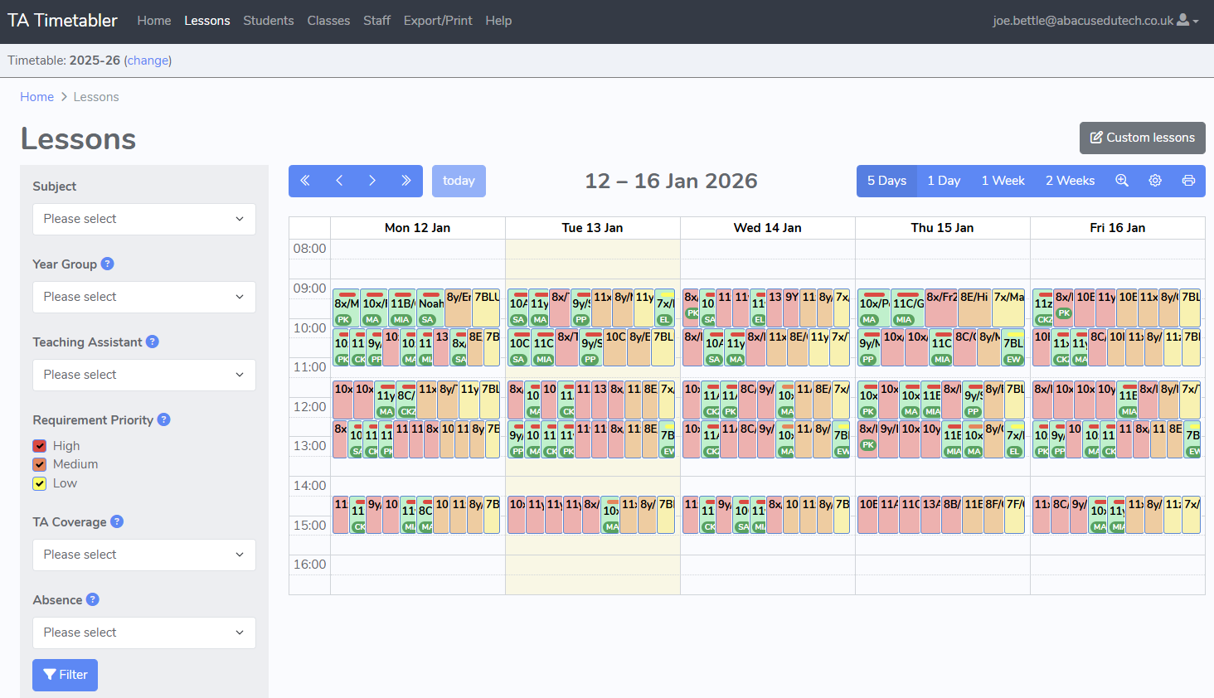
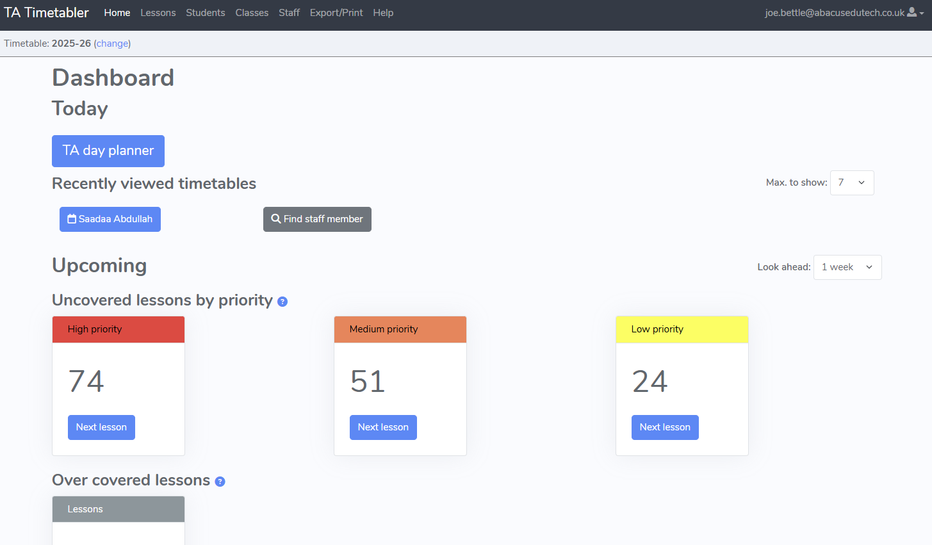
TA Timetabler
How it works

Slide 9
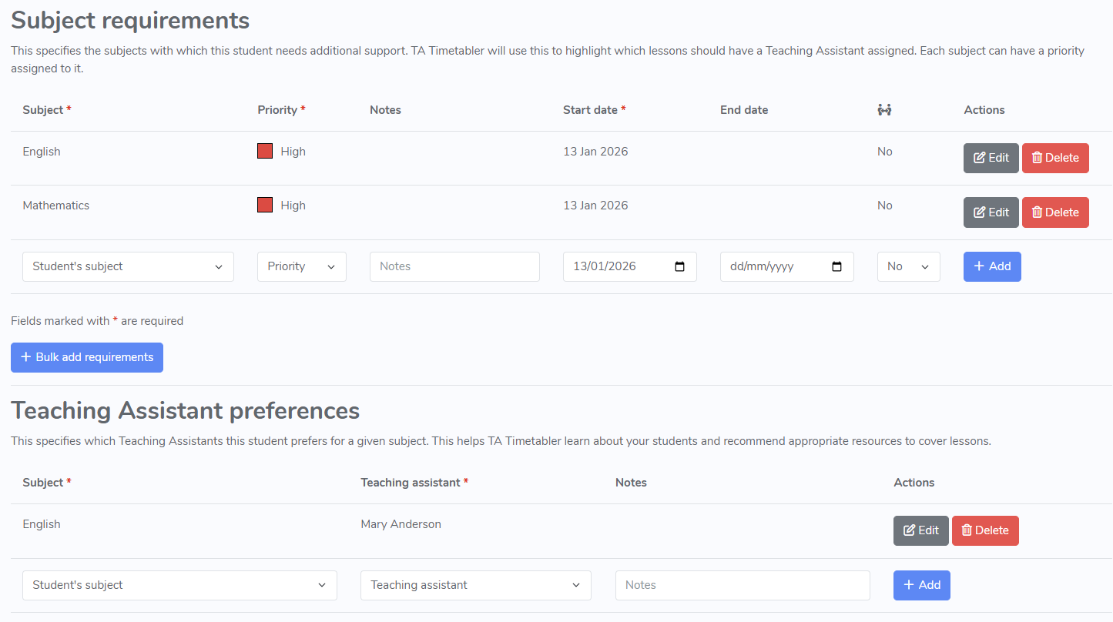
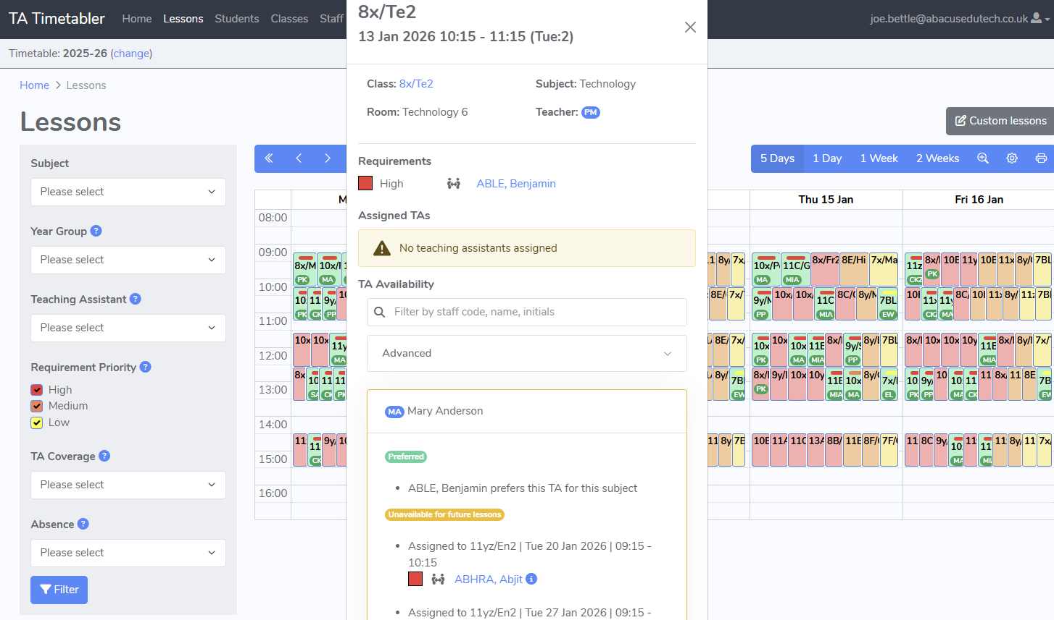
TA Timetabler
How it works

Slide 10
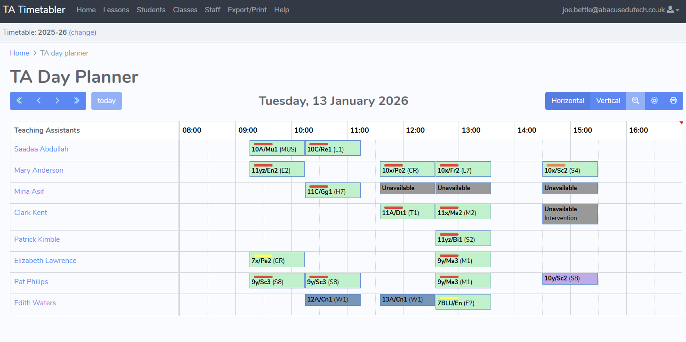
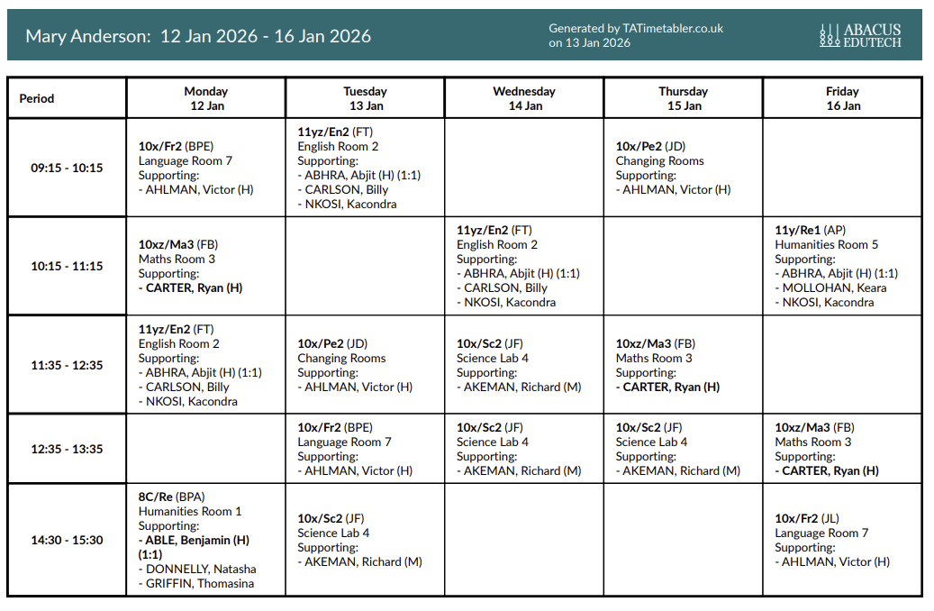
TA Timetabler
How it works

Slide 11
TA Timetabler
How it benefits schools
Client feedback is that TA Timetabler pays for itself several times over each year by:
  significantly reducing the time spent creating the initial TA Timetable at the start of the academic year
  significantly reducing the time spent each week, managing TA and pupil absence and redeploying staff as necessary
  helping to ensure that TAs are deployed more effectively and efficiently
It helps to ensure pupils get the support they deserve and are entitled to and provides an ongoing record of the support they have received
Communication is straightforward. It is very quick and easy to email timetables to TAs and to teachers, to show the support they will be receiving in lessons.

Slide 12
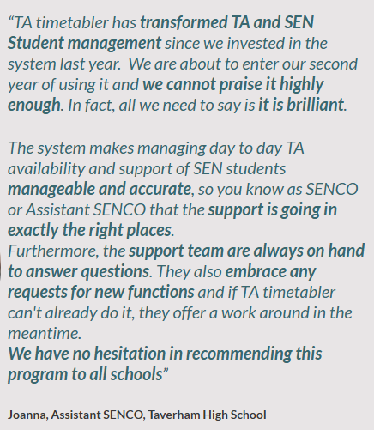
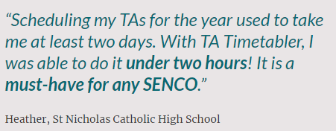
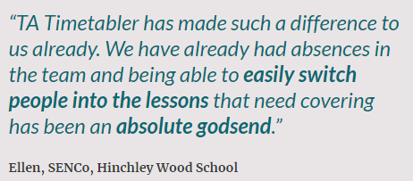
TA Timetabler
Testimonials

Slide 13
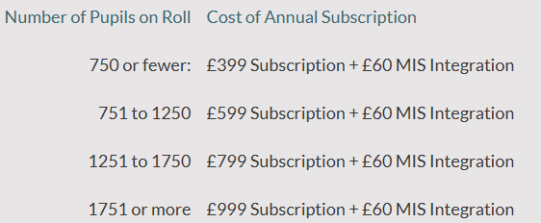
TA Timetabler
Pricing
Pricing information can be found here: https://www.abacusedutech.co.uk/ta-timetabler/pricing
The prices, as of January 2026, which include customer support, are shown here
We offer a 10% discount for multiple schools subscribing from the same MAT

Slide 14
TA Timetabler
Next steps
For more information, go to www.abacusedutech.co.uk/ta-timetabler
To sign up for a free 60 day trial, go to www.tatimetabler.co.uk/
For further information or to discuss your requirements, email sales@abacusedutech.co.uk or support@abacusedutech.co.uk

